Slide 1
Discrete Mathematics BCSC0010
Module 1
Sets(Lecture3)

Slide 2
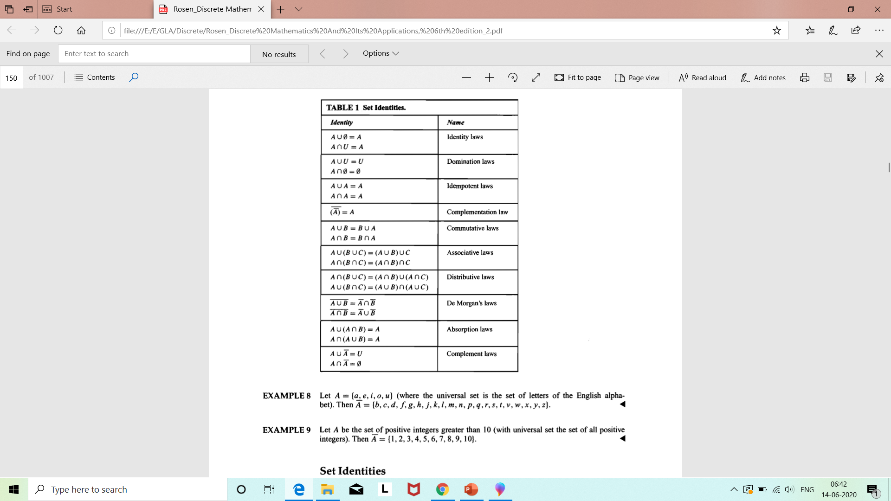
Set Identities

Slide 3
Methods to prove Set Equality
1. By Venn Diagram
2. By proving subsets of each other

Slide 4
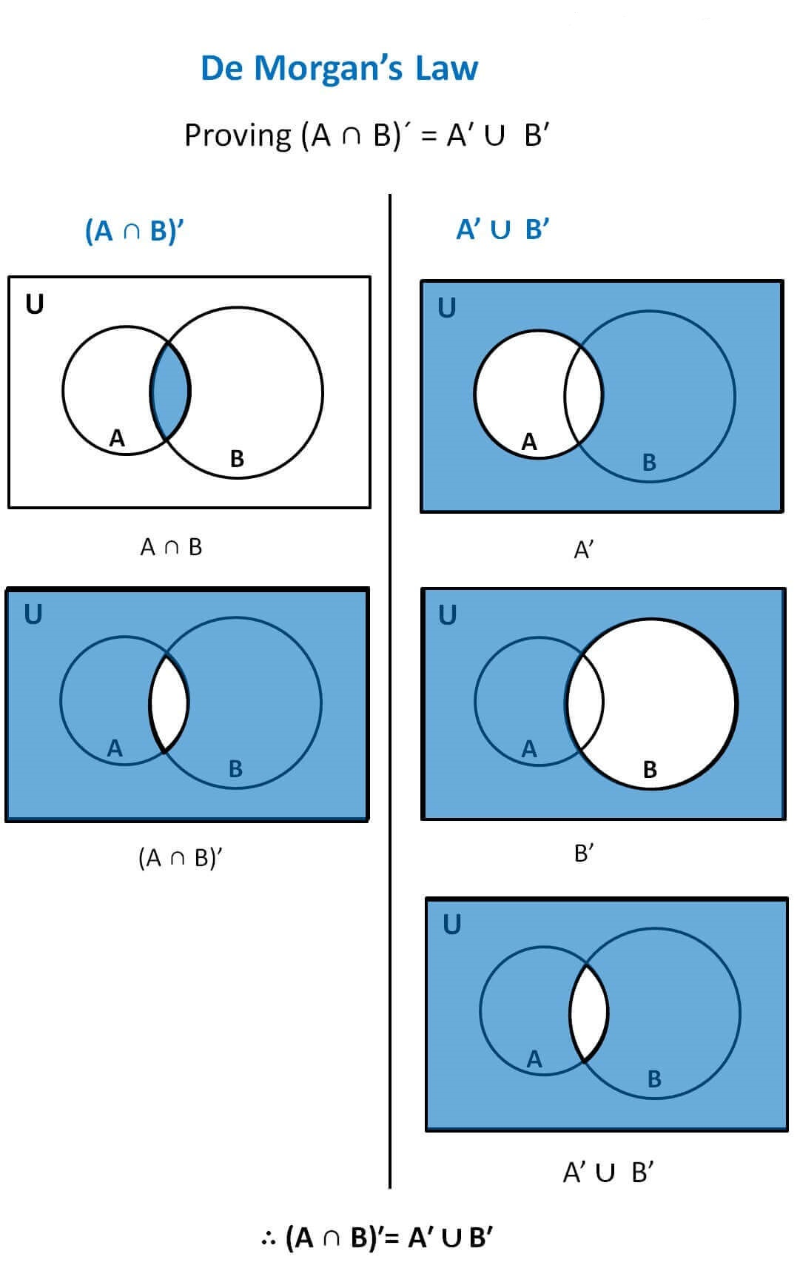
Example1 (By Venn Diagram)
Ref: https://www.teachoo.com/7038/1350/De-Morgans-Law/category/Complement-of-set/

Slide 5
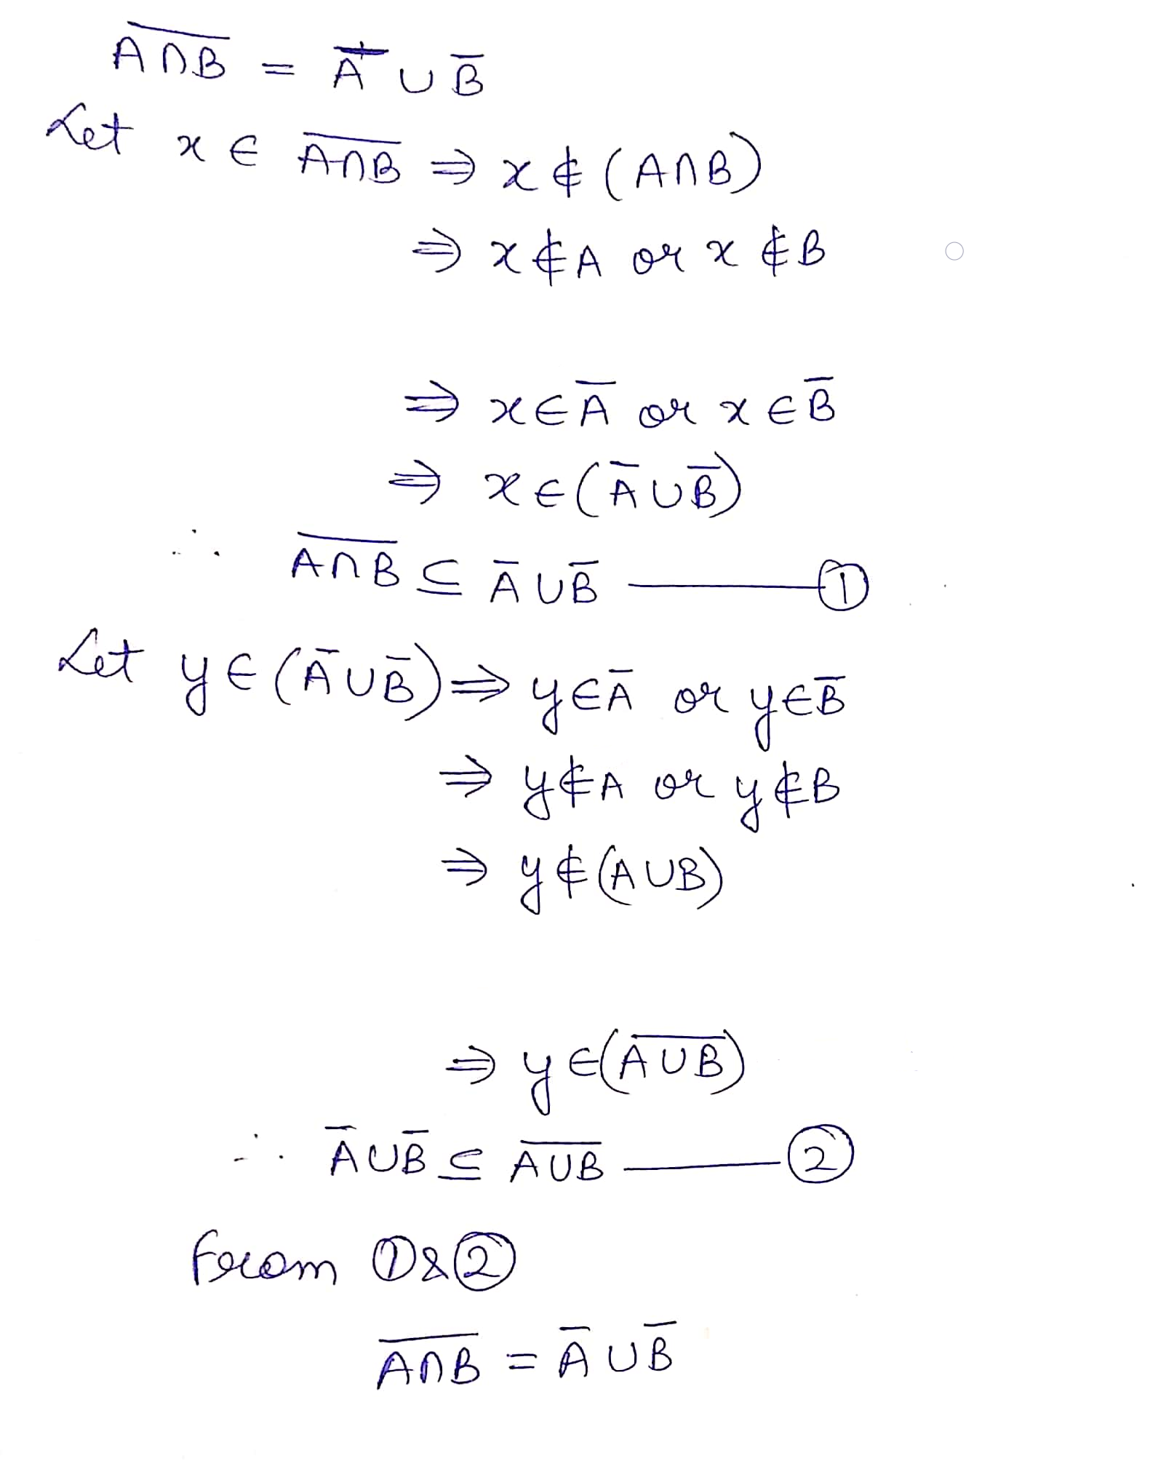
Example1 (By proving
subsets of each other)

Slide 6
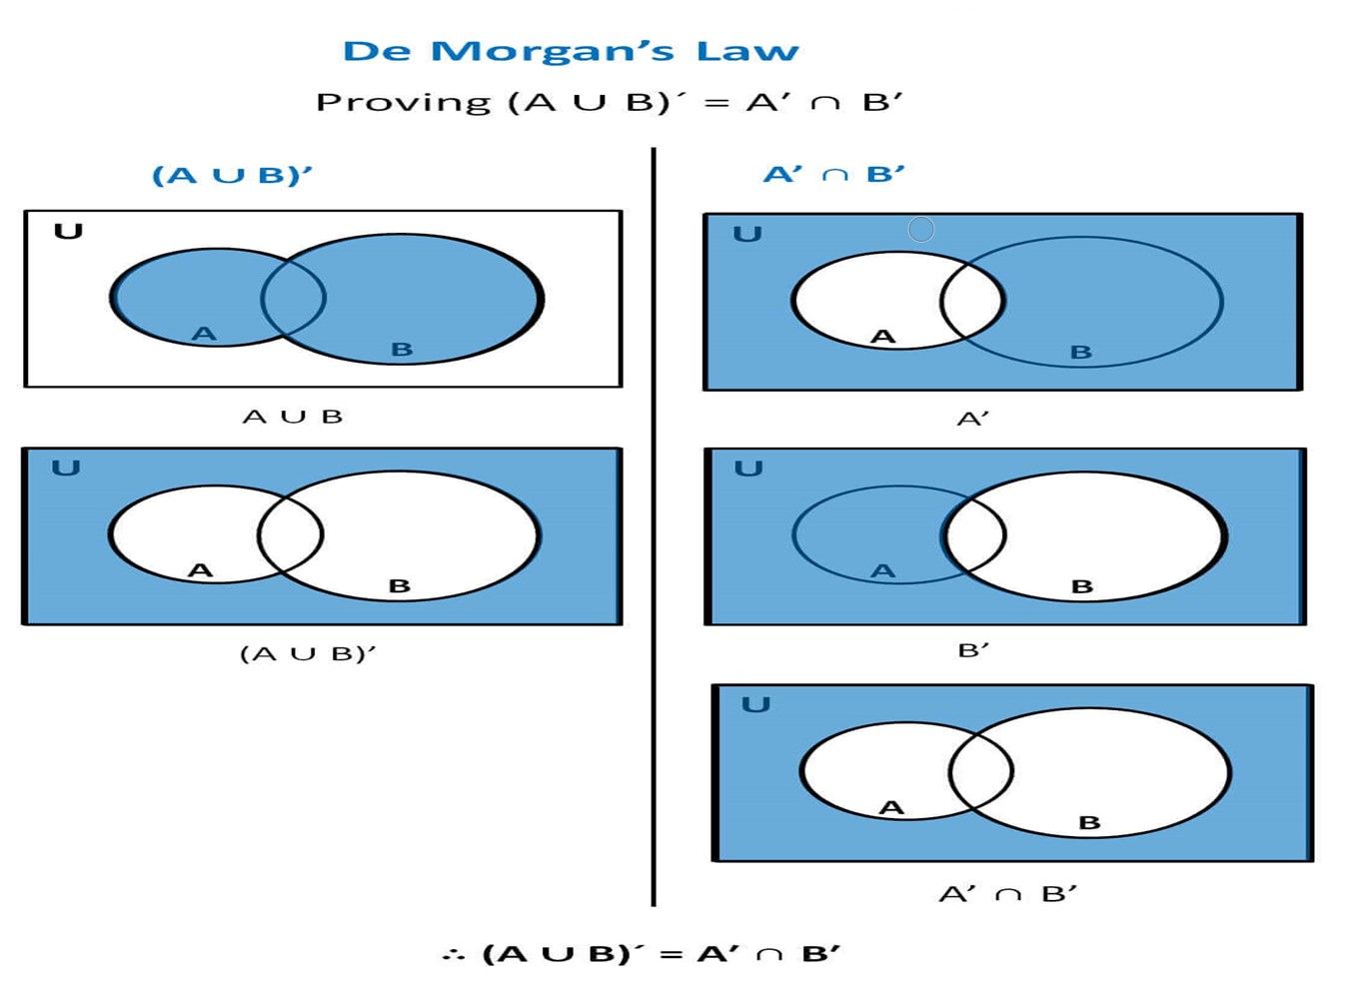
Example2 (By Venn Diagram)
Ref: https://www.teachoo.com/7038/1350/De-Morgans-Law/category/Complement-of-set/

Slide 7
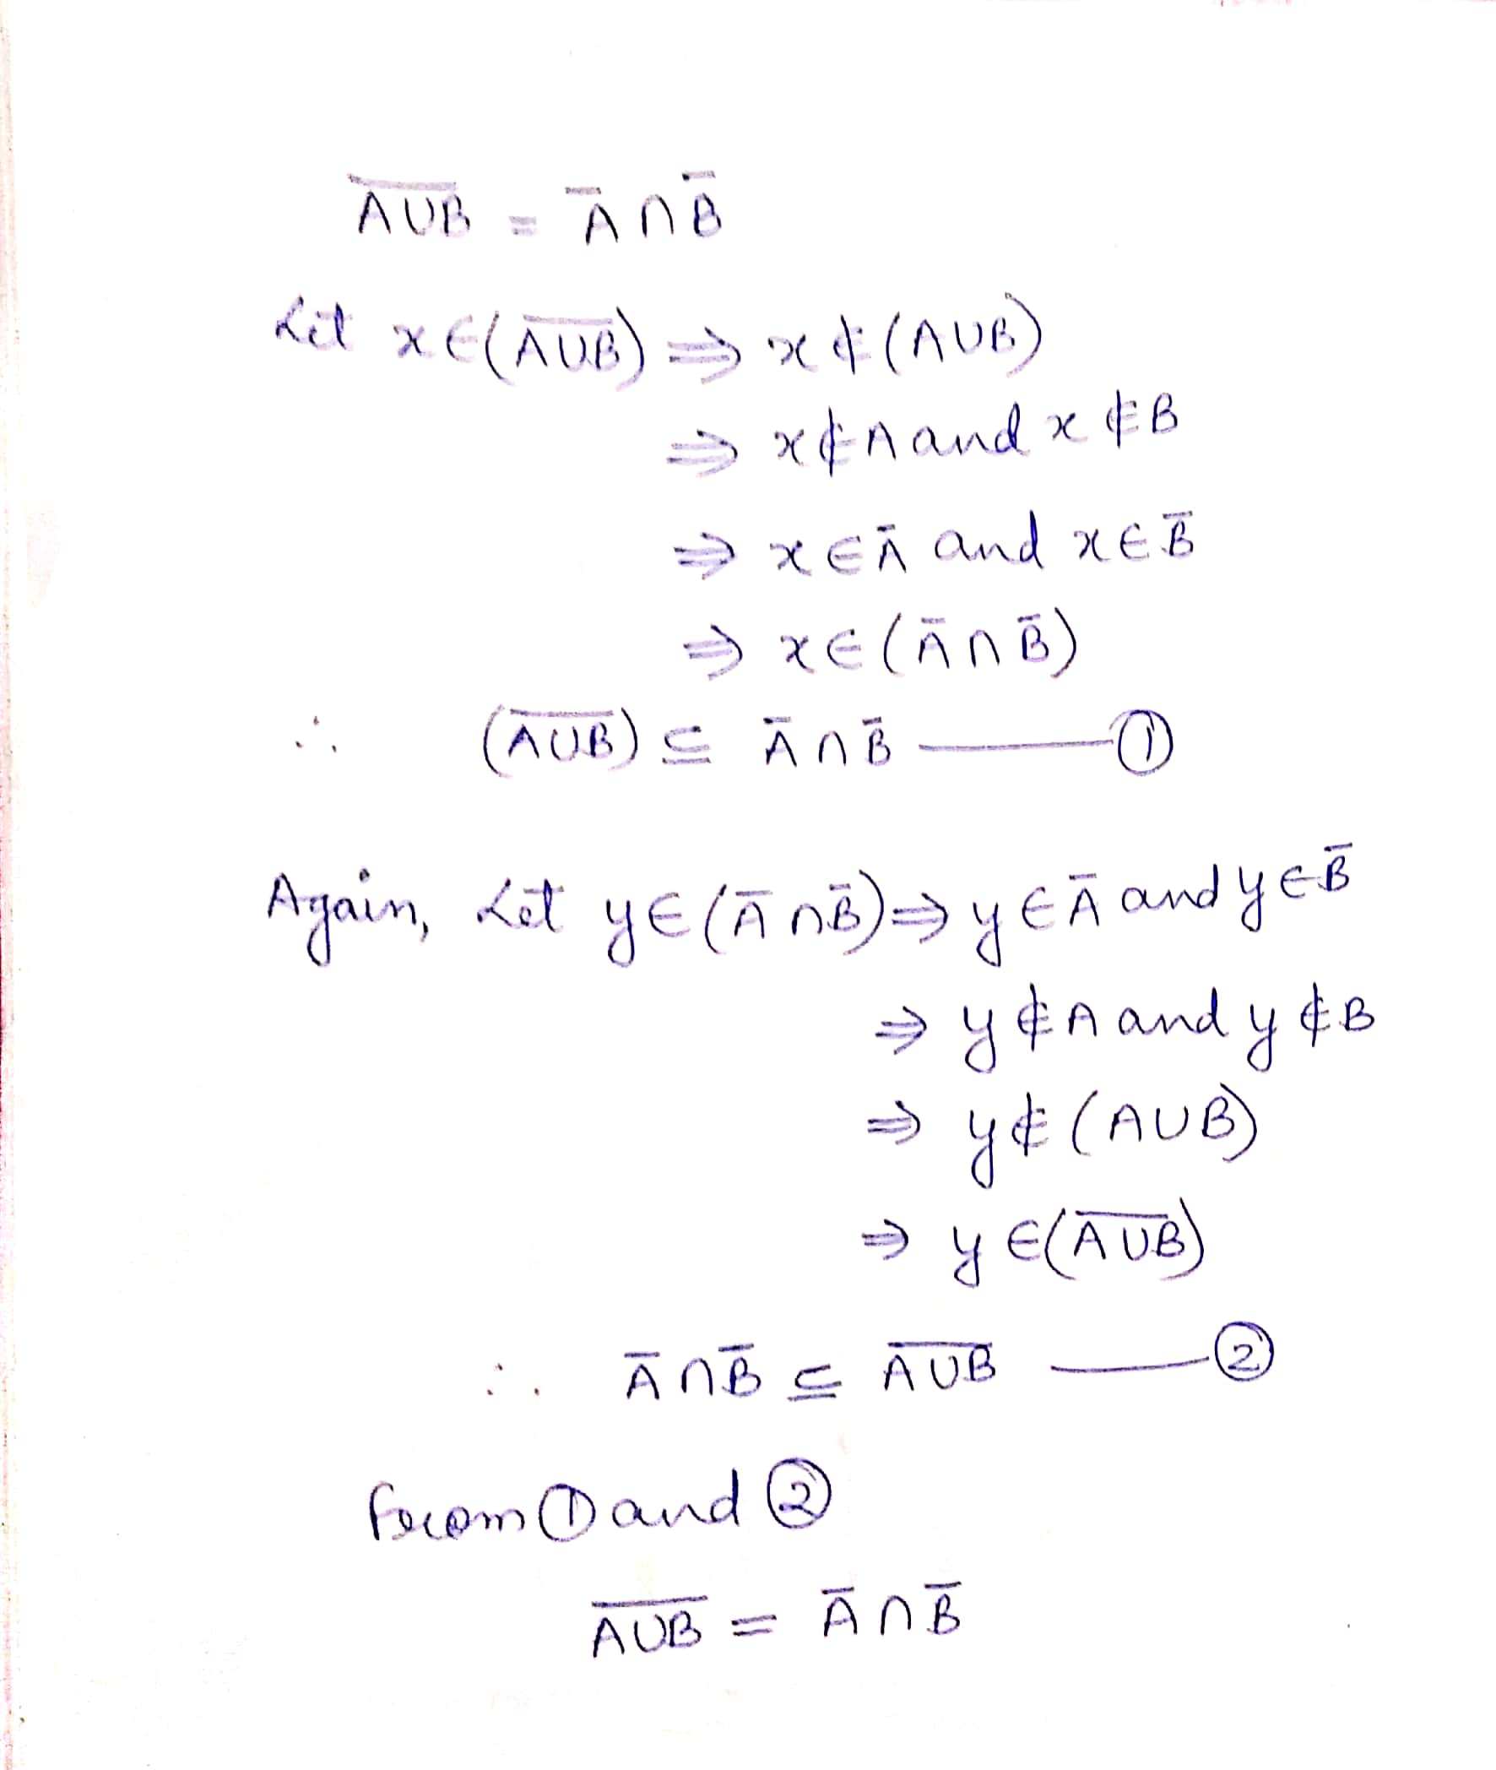
Example2 (By proving
subsets of each other)

Slide 8
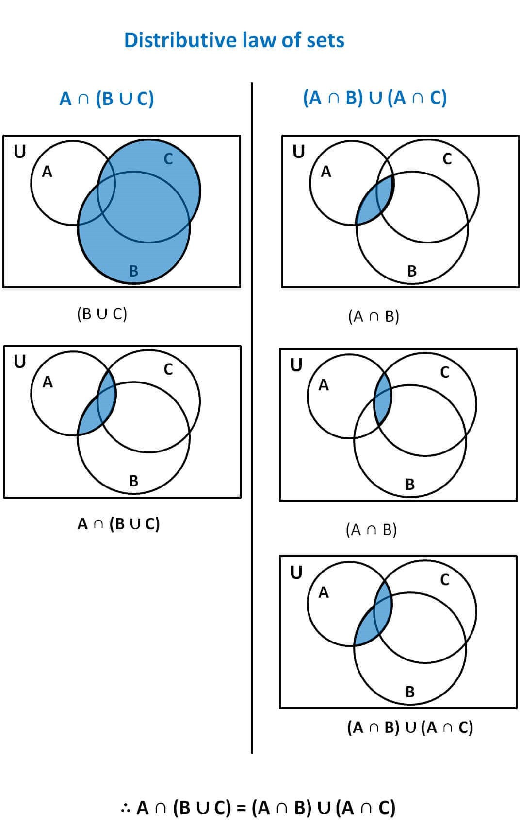
Example 4
Ref: https://www.teachoo.com/7035/1348/Proving-Distributive-law-of-sets-by-Venn-Diagram/category/Venn-Diagrams---Intersection/

Slide 9
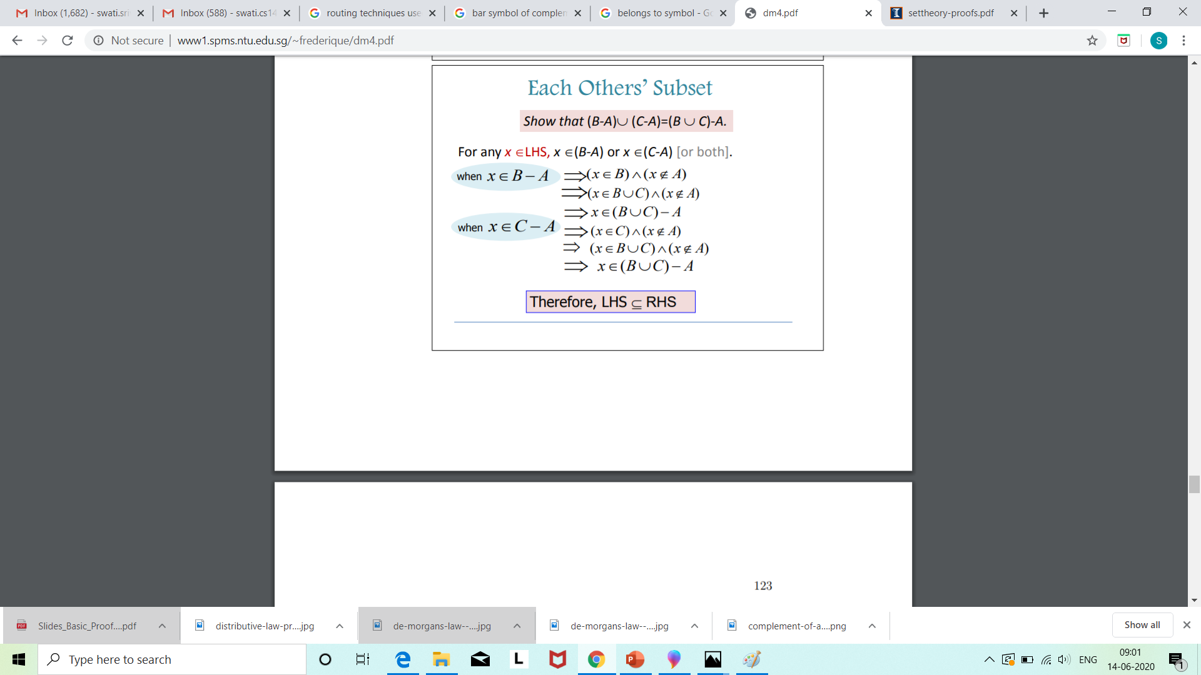
Example 5
Contd..

Slide 10
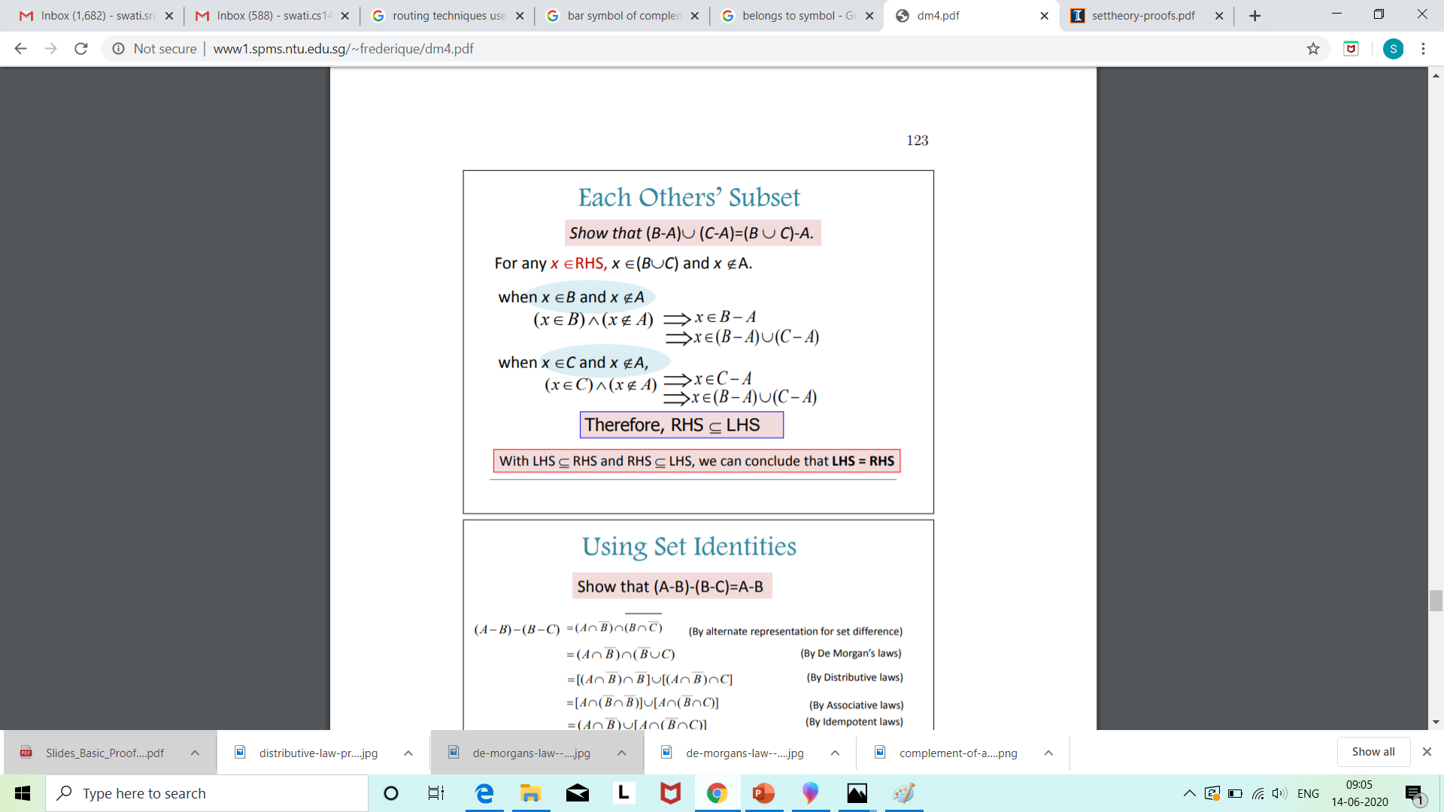
Ref: http://www1.spms.ntu.edu.sg/~frederique/dm4.pdf

Slide 11
Example 6 Show that (A – B) ∩ (C – B) = (A ∩ C) – B
Let x ∈ (A – B) ∩ (C – B)
⇒ x ∈ (A – B) and x ∈ (C – B)
⇒ (x ∈ A and x ∉ B) and (x ∈ C and x ∉ B)
⇒ (x ∈ A and x ∈ C) and x ∉ B
⇒ (x ∈ A ∩ C) and x ∉ B
⇒ x ∈ ((A ∩ C) – B )
So, (A – B) ∩ (C – B) ⊆ (A ∩ C) – B ... (1)
Contd…

Slide 12
Now, conversely
Let y ∈ (A ∩ C) – B
⇒ y ∈ (A ∩ C) and y ∉ B
⇒ (y ∈ A and y ∈ C) and (y ∉ B)
⇒ (y ∈ A and y ∉ B) and (y ∈ C and y ∉ B)
⇒ y ∈ (A – B) and y ∈ (C – B)
⇒ y ∈ (A – B) ∩ (C – B)
So, (A ∩ C) – B ⊆(A – B) ∩ (C – B) ... (2)
From (1) and (2),
(A – B) ∩ (C – B) = (A ∩ C) – B

Slide 13
Problem based on Principle of Inclusion Exclusion |A U B| = |A| + |B| - |A ⋂ B|
Among 50 patients admitted to a hospital, 25 are diagnosed with pneumonia, 30 with bronchitis, and 10 with both pneumonia and bronchitis. Determine:
(a) The number of patients diagnosed with pneumonia or bronchitis (or both).
(b) The number of patients not diagnosed with pneumonia or bronchitis.
Solution
Let U denote the entire set of patients. Let P and B denote the set of patients diagnosed with pneumonia and bronchitis respectively. Thus:
|U| = 50, |P| = 25, |B| = 30, |P ∩ B| = 10
Contd..

Slide 14
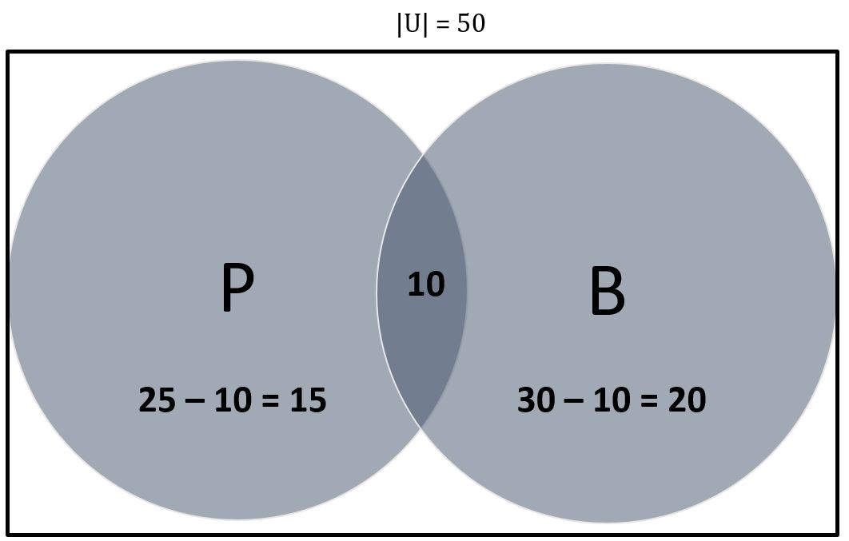
(a) By Venn Dig.,
|P ∪ B| = 15 + 10 + 20= 45
Thus 45 patients are diagnosed with pneumonia or bronchitis.
By using formula,
|P ∪ B| = |P| + |B| – |P ∪ B|
= (25 + 30) – (10) = 45
Thus 45 patients are diagnosed with pneumonia or bronchitis.
(b) |(P ∪ B)’|
= 50 – 45 = 5
5 patients are not diagnosed with pneumonia or bronchitis.

Slide 15
Problem based on Principle of Inclusion Exclusion(for 3 sets) ∣ A ∪ B ∪ C ∣ = ∣ A ∣ + ∣ B ∣ + ∣ C ∣ − ∣ A ∩ B ∣ − ∣ A ∩ C ∣ − ∣ B ∩ C ∣ + ∣ A ∩ B ∩ C ∣
A large software development company employs 100 computer programmers. Of them, 45 are proficient in Java, 30 in C#, 20 in Python, 6 in C# and Java, 1 in Java and Python, 5 in C# and Python, and just 1 programmer is proficient in all three languages above. Determine the number of computer programmers that are not proficient in any of these three languages.
Solution
Let U denote the set of all employed computer programmers and let J, C and P denote the set of programmers proficient in Java, C# and Python, respectively. Thus:
|U| = 100, |J| = 45, |C| = 30, |P| = 20, |J ∩ C| = 6, |J ∩ P| = 1, |C ∩ P| = 5, |J ∩ C ∩ P| = 1
Contd..

Slide 16
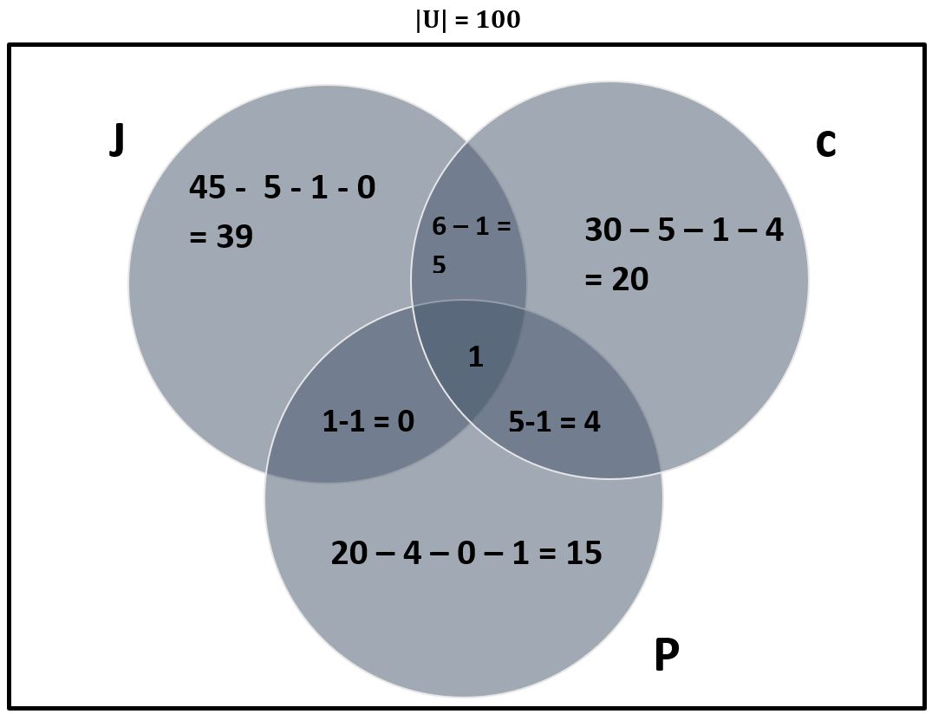
|J ∪ C ∪ P|
= 39 + 5 +20 +4 +15 + 1
= 84
Now calculate the complement:
|(J ∪ C ∪ P)’ | = |U| – |J ∪ C ∪ P|
= 100 – 84
= 16
16 programmers are not proficient in any of the three languages.

